Slide 1


Pro Net Solutions EMPOWERING DREAMS, ELEVATING LIVES!
Welcome to Pro Net Solutions, your trusted partner in achieving financial independence. We empower individuals with cutting-edge technology and educational resources, unlocking a world of possibilities in the financial markets.

Slide 2
Disclaimer
Please review this disclaimer carefully before relying on information.
Pro Net Solutions provides financial education, market views, and tools for informational purposes only. We do not offer financial, investment, or legal advice. Trading and investing in financial markets involve risks, and past performance is not indicative of future results. Users should conduct their own research and consult with a professional before making any financial decisions. Pro Net Solutions is not responsible for any financial losses incurred through the use of our services

Slide 3
Our Vision A Financially Empowered Community
Empowering Dreams – Helping individuals turn their aspirations into reality by providing them with the right knowledge, tools, and opportunities. Whether it’s financial independence, career success, or personal growth, the goal is to inspire action and confidence.
Elevating Lives – Not just personal success, but uplifting entire families and communities by fostering financial stability, smart decision-making, and sustainable growth. When people are financially educated and empowered, they can lead better lives and contribute positively to society.
OUR VISION
AI-Driven Trading Tools
Educational Resources
Diversify Business
Opportunities

Slide 4

Our Goals: Empowering You for Success
1
Through Financial Literacy.
2
By Providing Market Insights And Trade Opportunities.
.
3
Innovation in Trading Technologies Like Algo Tools And Indicators etc.
4
By Providing Capital Growth Specialist.
5
Expansion into Emerging Industries.
6
Multiple Revenue Streams for Subscribers.

Slide 5



Forex, Metals & Indices Educators
Expert Knowledge
Our educators are highly skilled and experienced in the forex, gold, and indices markets.
Hands-On Training
We provide practical training and real-world examples to help you apply your knowledge.
Personalized Support
We offer ongoing support and guidance to ensure your success in the financial markets.

Slide 6


Financial Literacy
Forex
.
Gold
Indices
.
Stocks

Slide 7




Alert Providers: Gaining an Edge in the Markets
ProSignals Inteliigence Team
Our team of experienced specialist provides valuable insights and market signals based on their expertise.
AI-Driven Analytics
Our AI analyze vast amounts of data to improve accurate trading signals and improve decision-making.
Informed Trading Decisions
Our signals provide users with a solid foundation for making informed trading decisions and maximizing their potential.

Slide 8


AI Integration in Trading with Our Algo Tools
1
Automated Strategies
Our AI algo tools automate your trading strategies, freeing you from constant monitoring and manual execution.
2
Improved Accuracy
AI's ability to analyze vast amounts of data leads to more accurate trading signals and predictions from our AI Algo Tools.
3
Enhanced Trading Performance
Our AI-powered trading tools help you achieve better results and maximize your profits.

Slide 9



Capital Growth Specialist
2
Profit Optimization
We implement strategies to maximize your returns and achieve your financial goals.
Risk Management
Our team works to minimize risk and
protect your capital.
1
Personalized Strategies
We tailor our services to your individual
needs and risk tolerance.
3

Slide 10




Future Products & Expansion: Embracing New Opportunities
Drop Shipping
We are integrating drop shipping as an emerging career option, offering clothing apparel and wellness products.
Crypto Coin
We are launching a crypto coin backed by real estate projects, providing a secure investment opportunity.
Gaming
We are expanding into skill-based and fantasy gaming, creating new avenues for users to earn.
At Pro Net Solutions, we are constantly innovating and expanding to create new opportunities for our community. We believe in empowering individuals with the knowledge and tools they need to achieve financial independence and success.

Slide 11


Our Community Can Earn:
Multiple Avenues for Growth
Using Our Product & Services
Financial education, Utilize AI-driven tools, signals, and expert strategies to enhance trading profitability.
Promoting Our Services
Earn commissions by referring clients through our affiliate.
Diversifying Their Portfolio
Invest in forex, gold, crypto, and indices to achieve stable financial growth.

Slide 12
Pro Net Solutions Plans and Add-ons
STANDARD PLAN $60/MONTH
MARKET INSIGHTS AND TRADE OPPORTUNITIES
US30 & US100
STOCKS
GOLD
F & O
FOREX
CRYPTO
ADD-ON PLANS
DROP SHIPPING
FANTASY GAMING
REAL ESTATE
AI BASED ALGO TOOLS AND INDICATORS
GAMING & ESPORTS
GAMIFICATION
FINANCIAL EDUCATION &
ONE-ON-ONE MENTORSHIP

Slide 13
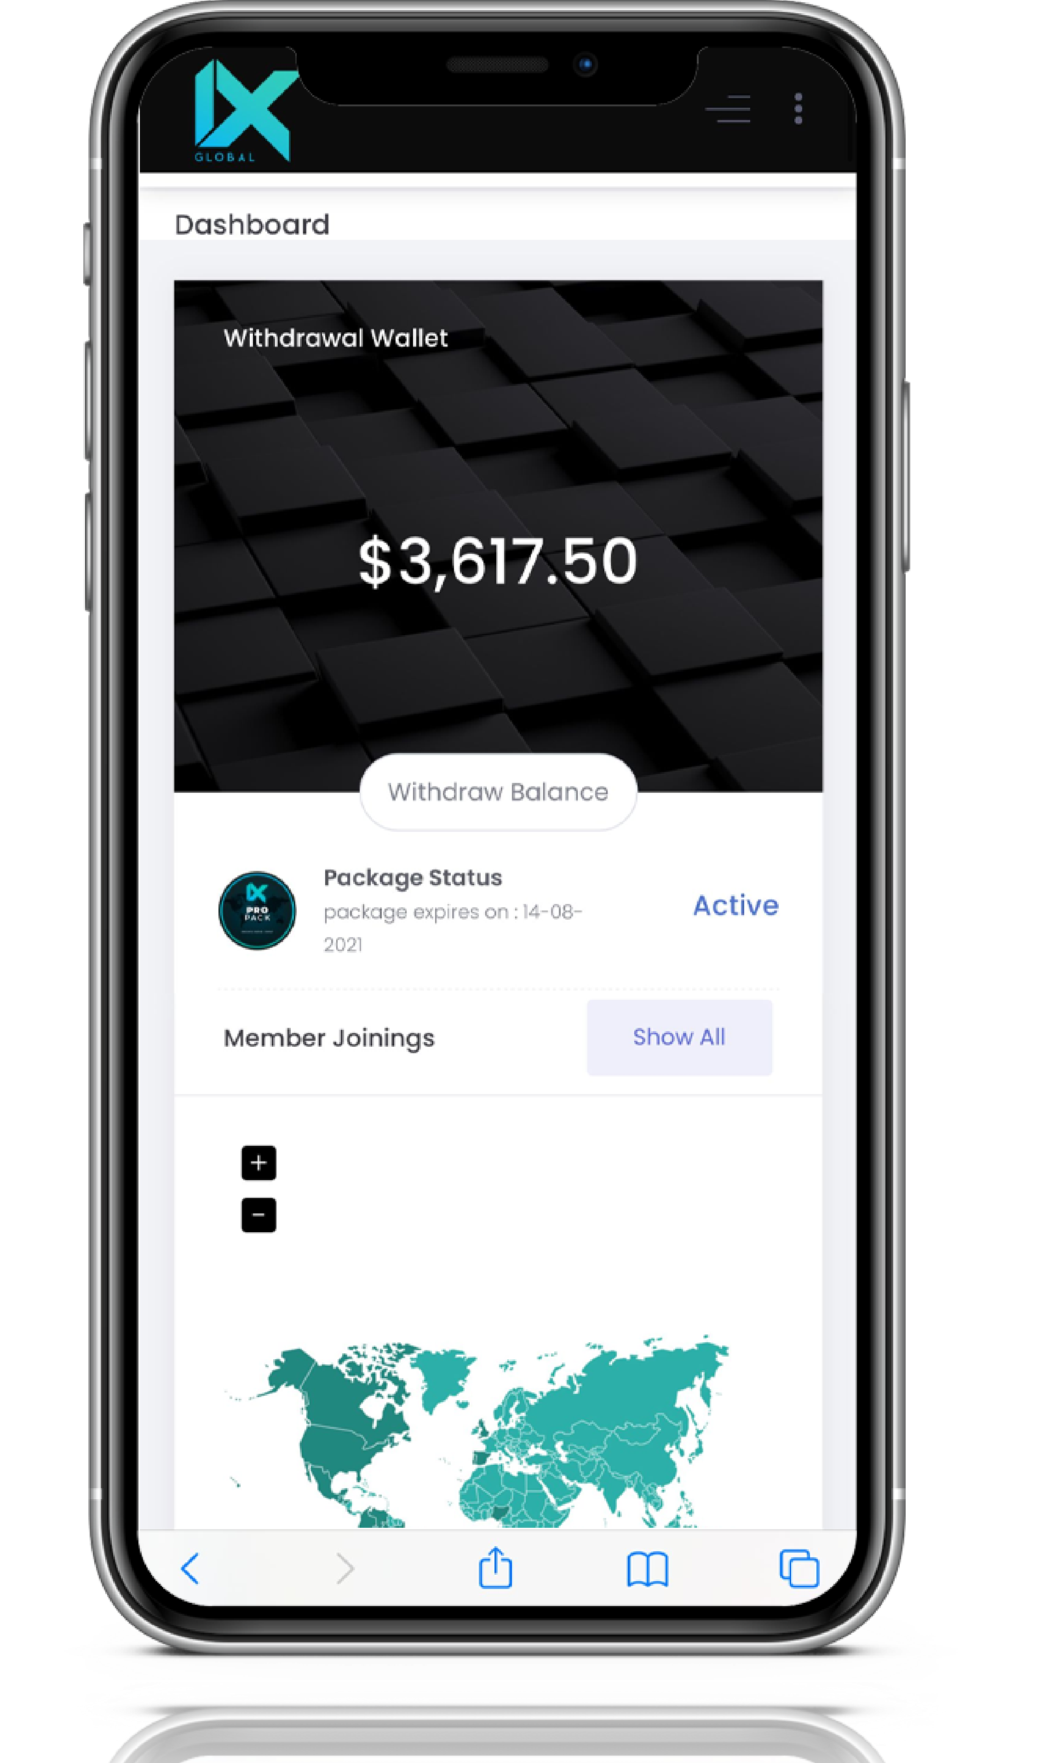
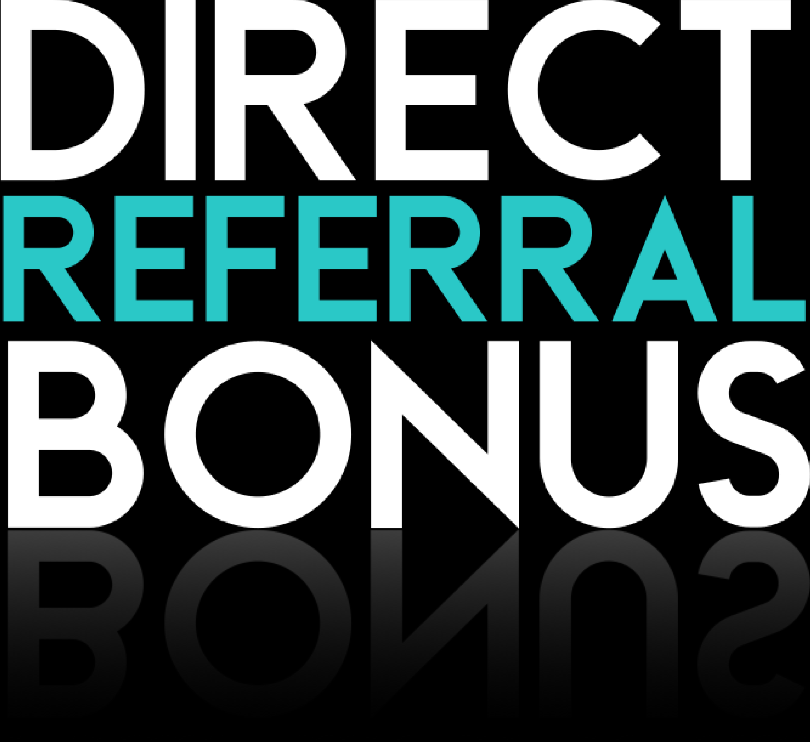
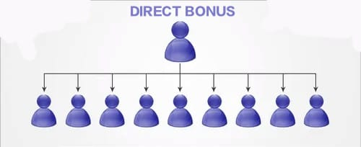
Direct Referral Bonus ( 10% on each affiliate)
Earn 10% from your direct referral’s which
helps leaders to support and grow their teams.
Residual income from each new and renewal also
Generate a residual for
each direct referral
📊 Reward Calculation Basis - 70% of $60 = 42 PV All bonuses and other rewards will be calculated based on 42 PV.

Slide 14

Fixed Monthly Bonus
*"In the first level, the payout included a direct bonus of $18 and a fixed bonus of $42
, making the total $60."
Help your affiliates to create their community of 3x3 direct referrals and receive a monthly bonus.
MEMBERS: 1 + 3 DIRECT
BONUS: $60
MEMBERS: 12
BONUS: $225
MEMBERS: 40
BONUS: $450
MEMBERS: 120
BONUS: $900
MEMBERS: 250
BONUS: $2000
MEMBERS: 500
BONUS: $4000
L1
L2
9
9
9
9
9
L3
27
27
27
27
L4
81
81
81
L5
130
130
L6
250
Calculated on a monthly cycle (every 4 weeks) and is applicable only after the completion of the designated levels; it is capped at 40% of the high-performance directs team. Roll-over provisions apply as per internal guidelines.

Slide 15


BINARY BONUS
*Active User
ZENITH
Earn extra 10 - 18% binary bonus from total number of active subscribers.
Encourages fast team growth.
*Binary
SOVEREIGN
Percentage
MOGUL
LUMINARY
VANGUARD
📊 Reward Calculation Basis
✅ 70% of $60 = 42 PV All bonuses and other rewards
will be calculated based on 42 PV.
TRAILBLAZER
CATALYST
INNOVATOR
PIONEER
RISER
SPARK
IGINATOR
3
10%
12
10%
40
10%
120
10%
250
10%
500
15%
1111
15%
2777
15%
5555
15%
11111
18%
22222
18%
44444
18%
BRANDED MERCHANDISE
TRAVEL VOUCHER FOR LOCAL EVENT
TRAVEL VOUCHER FOR NATIONAL EVENT
NATIONAL TOUR PACKAGE
3DAYS AND 2 NIGHTS (SELF
PREMIUM TRAVEL FUND WITH SPOUSE
EXCLUSIVE EVENT INVITATION NATIONAL
LEISURE PERK FOR ADVANCE TRAVEL WITH FAMILY
EXCLUSIVE EVENT
INVITATION INTERNATIONAL
LUXURY LIFESTYLE PACKAGE ON CHOICE
LUXURY LIFESTYLE PACKAGE ON CHOICE
- N.A.-
HOME OFFICE SETUP VOCHER

Slide 16
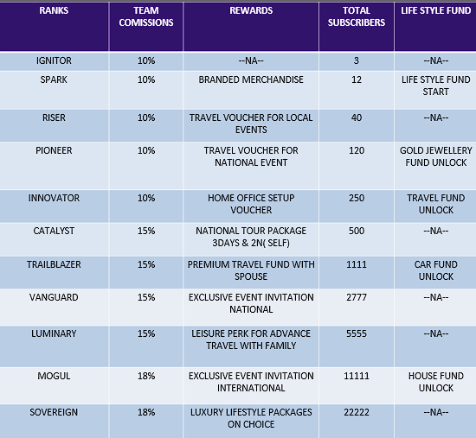
BINARY BONUS
Binary Bonus: Calculated on a weekly basis, always determined on the weak side volume. Any extra binary bonus volume is carried forward to the next week.If an affiliate does not maintain an active subscription, any carried-forward binary bonus will lapse 28 days after the subscription due date. However, upon reactivation using the same Affiliate ID, while the accumulated volume bonus will be reset (lapsed), the team count remains 100% intact.

Slide 17

LIFE STYLE FUNDS
- Jewellery Fund: 2%
- Travel Fund: 3%
- Car Fund: 3%
- House Fund: 2%
How It Works:
- 10% of all payouts are automatically deducted and allocated to these funds.
- Members receive their rewards upon qualifying for respective ranks.
- Ensures long-term retention, motivation, and luxury lifestyle benefits.
Generate a residual for
each direct referral

Slide 18
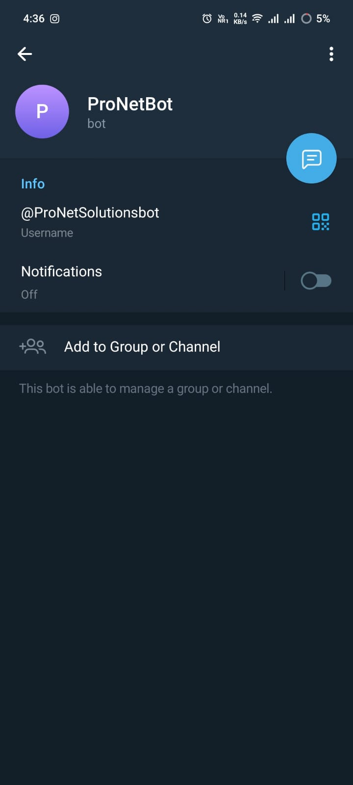
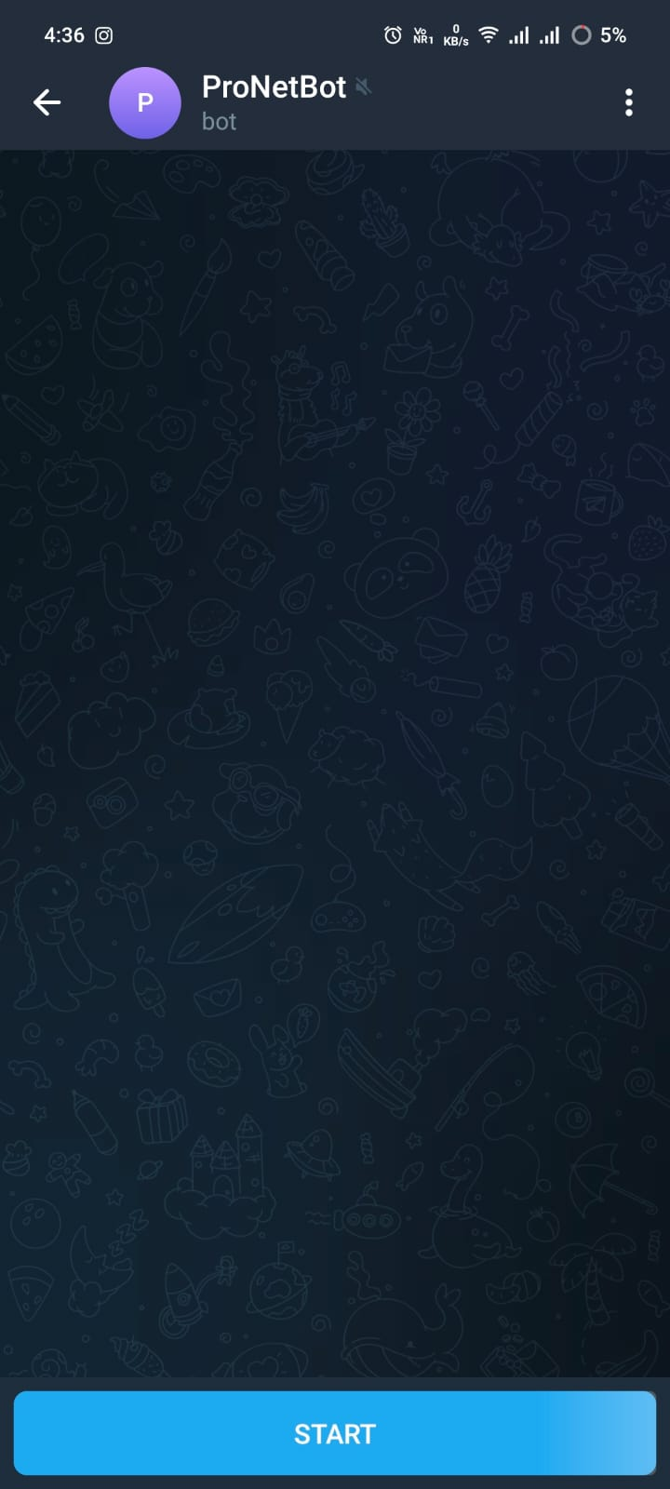
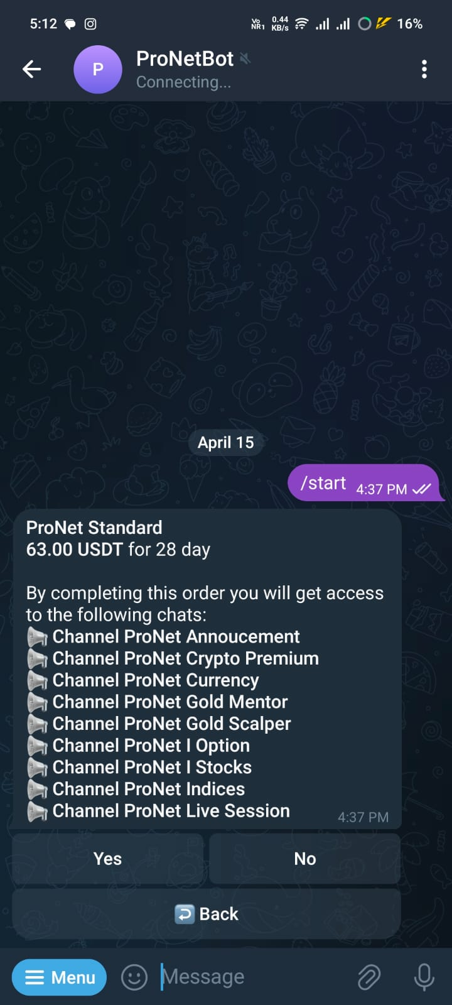
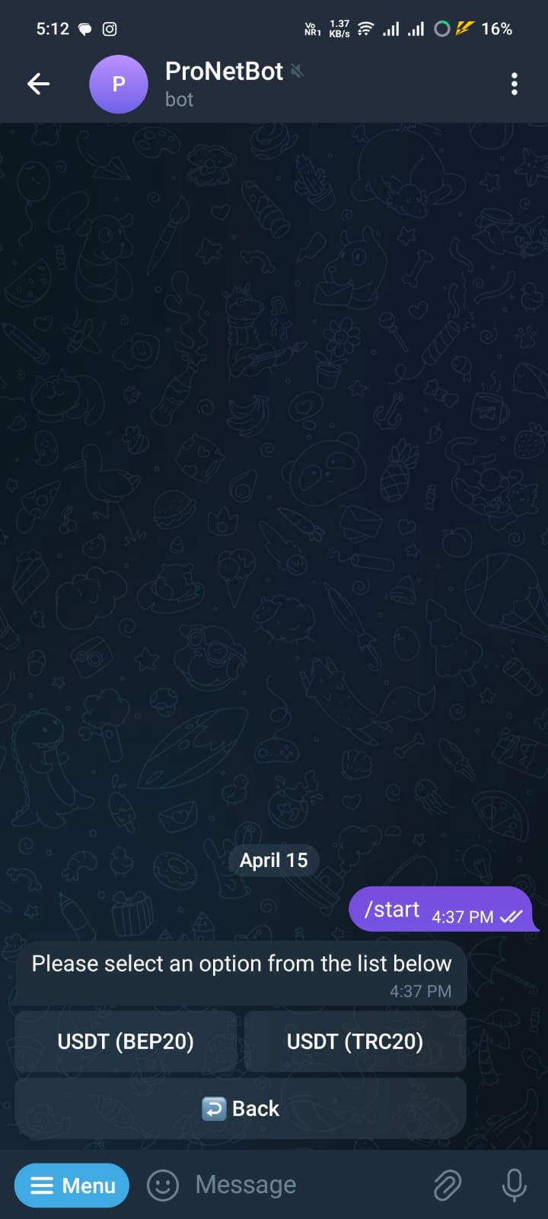
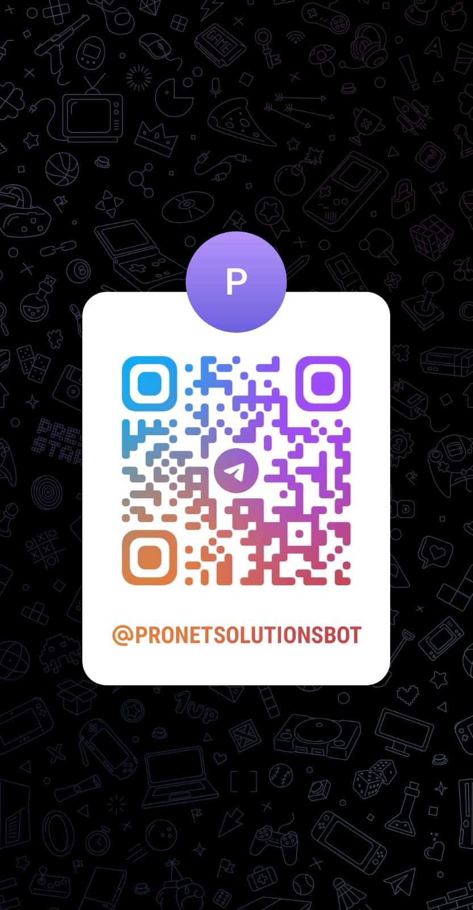
HOW TO CONNECT USING TELEGRAM BOT
DOWNLOAD & OPEN TELEGRAM APP FROM GOOGLE PLAY STORE OR APP STORE .
SEARCH FOR @ProNetSolutionsbot or SCAN THE QR CODE
THEN OPEN IT & PRESS START .
SELECT ProNet Standard AND CONTINUE TO PAYMENT OPTION.
ENJOY OUR SERVICES.

Slide 19
THANK YOU
Thank you for taking the time to review our presentation and consider the opportunities with Pro Net Solutions. We deeply appreciate your interest and the chance to share how our solutions can empower your business for sustained growth and security. As you deliberate on your decision, please know that our team is fully committed to supporting you with any additional insights or clarifications you may need. We are excited about the possibility of partnering with you and contributing to your success. Wishing you a bright and secure future, filled with innovation, growth, and lasting prosperity.

